Slide 1
Capstone Project Loan Default Prediction
Classification
Wasil Ahmad

Slide 2
Problem Definition
The objective of this project is to develop a predictive classification model that can accurately forecast the likelihood of a customer defaulting on their home loan.
BAD: Target Variable.
LOAN, MORTDUE, VALUE, REASON, JOB, YOJ, DEROG, DELINQ, CLAGE, NINQ, CLNO, DEBTINC: Independent Variables
Which factors (features) most significantly contribute to a customer's likelihood of defaulting on a loan?
Can a predictive model accurately distinguish between applicants who will default and those who will not?

Slide 3
Exploratory Data Analysis (EDA)
The data contains skewed data. Most have a skew of greater than 1.
Credit history and employment stability (or lack of major derogatory reports) play a major role in loan approval, suggesting a clean financial history is common among applicants.
Debt consolidation loans are less likely to default, while home improvement loans have a slightly higher default rate, which could be tied to applicant financial risk profiles.
Loan amount plays a role in default behavior, with smaller loans being more likely to default.
Strong correlation exists between Amount Due and Current Value of Property.
Outliers are retained since they do not seem unreasonable. Median imputation done to help fill in the missing values

Slide 4
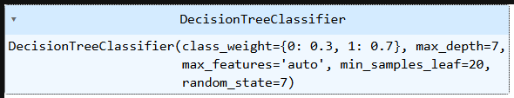
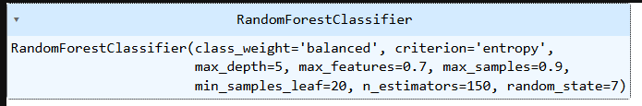
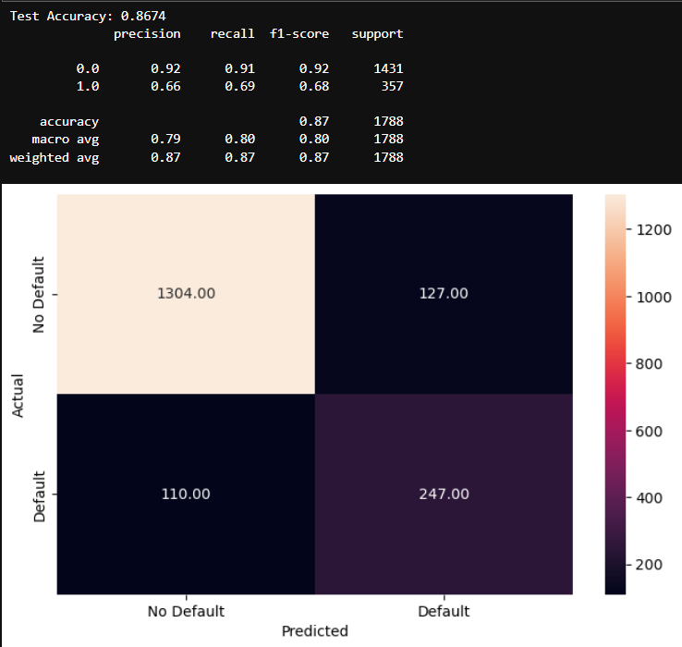
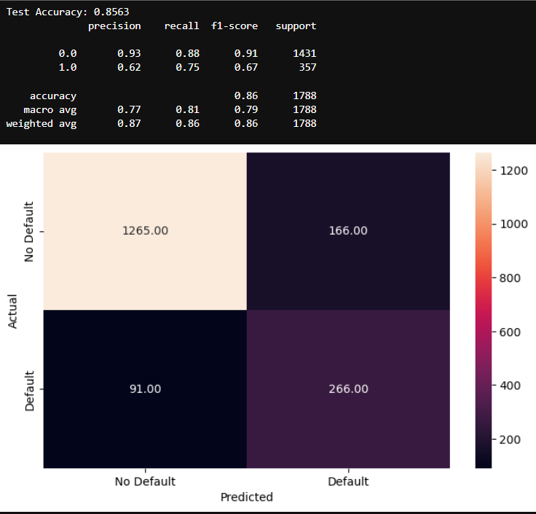
Models

Slide 5
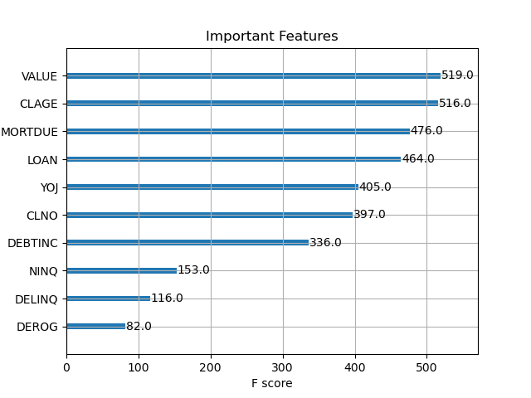
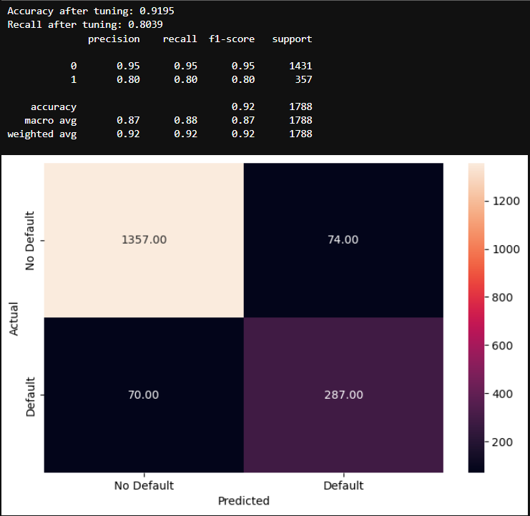
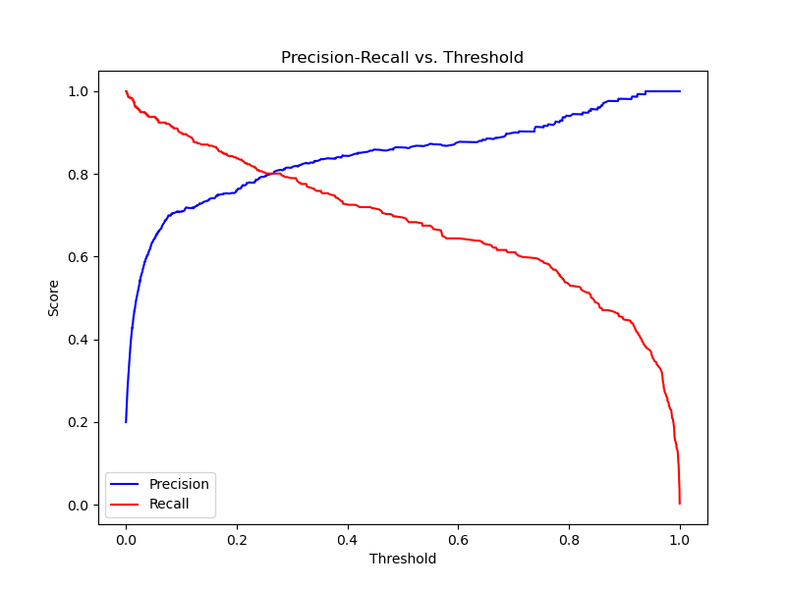
XGBoost Model

Slide 6
Key Recommendations for Improvement
Feature engineering
Threshold Tuning
Hyperparameter Tuning
Handling Imbalanced Data
Model Interpretability
Try alternative methods for treating missing values like
KNN Imputation for Missing Values
Dropping column

